Slide 1
Research on AI-Based System for COVID-19 Prevention
1Mrs.Beena K, 2Ranjitha HD, 3 Sushmita BK, 4 Ramya R, 5Bhavyashree R.
1 Assistant professor, 2,3,4,5Undergraduates, 1Department of Computer Science and Engineering,
K. S. Institute of Technology, Bangalore, India.

Slide 2
CONTENT
Introduction
Literature Survey
Problem Statement
Scope Statement
Methodology
Contribution to Society
References

Slide 3
INTRODUCTION
In early December 2019, an outbreak of coronavirus disease (COVID-19), caused by a novel severe acute respiratory syndrome coronavirus 2
Response to such acts,We are aiming to design a causative method and Prevention strategies.
First Iteration and Refinement :-Real time data analysis of face mask detection and social distance measuring.
Second Temperature sensor and Hand sanitizer dispenser.

Slide 4
PROBLEM STATEMENT
The last statistics provided by the WHO show 306,194,981 confirmed cases, 5,503,829 deaths and 259,065,020 Recovered but, infection is continues increasing till now.In this consequence, it is a very important mission to prevent solution so it can be reduce the spread of COVD-19.
Therefore use of mask ,sanitizer so on .,enables effective prevention and further spread of the virus.
To ensure that the mask and social distance is been followed there needs to be an automatic technique that can prevent highly accurate intelligent system for mask detection and social distance through image processing.
Interfaced Automatic Temperature and Hand sanitizer Through based on contact-less .

Slide 5
SCOPE
The system is easy to operate and it can be used in crowded areas.it also ensures the compliance of not wearing mask and social distance (if minimum distance is not maintained).
Sends a continuous humming sound.(if persons has more then normal temp).
If we press sanitizer tap then sensor observe distance (line-of-sight) reads and instructs the servo motor to actuate and dispense

Slide 6
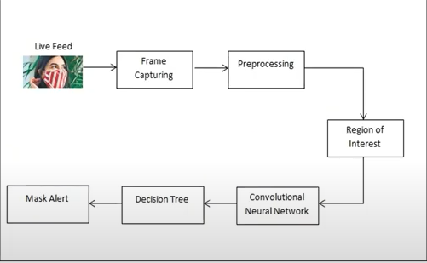
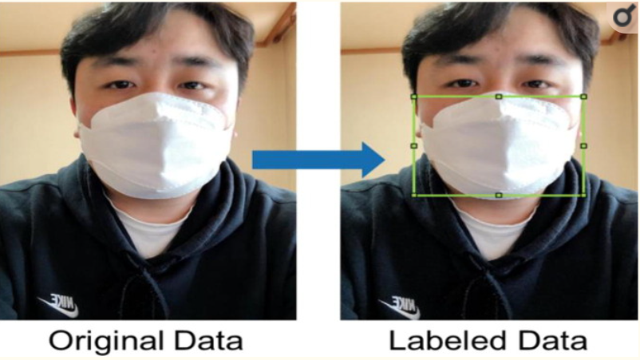
System Architecture
1.Prepare data collected from data access and pre-processing ground-truth labelling, and simulation-based data generation
2. After prepare data, the Train model generated from model design, hyperactive parameter tuning, image based on automated labelling with a pre-trained model for facial recognition
3. Train Object detection model based Convolutional Neural Network
4. Generate the Mask alert

Slide 7
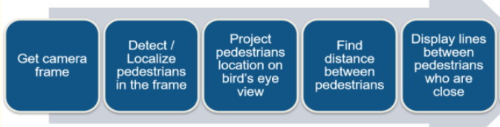
Model B
Prepare camera frame in multi angle
Yolov2 file identifies pedestrians' foot recognition and then project pedestrians using trained model the trained model using the classification ion of daBirdseyerds eye concept.
Finds distance between pedestrians who are close
Sends alarm

Slide 8
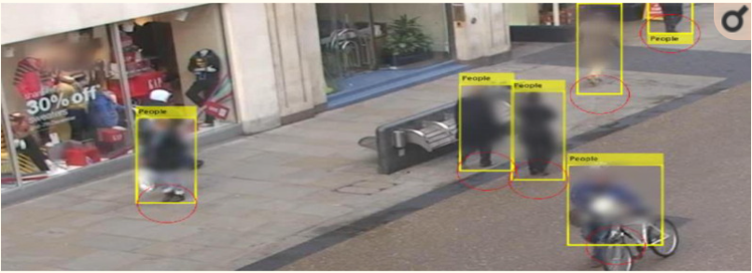
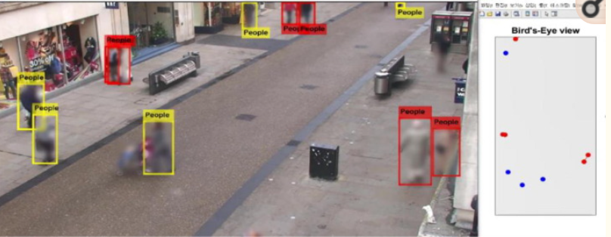
Social distancing measurement using Faster - BEV
Social distancing measurement using Faster - RCNN.
rounded marked for social distancing for distance measurement.

Slide 9
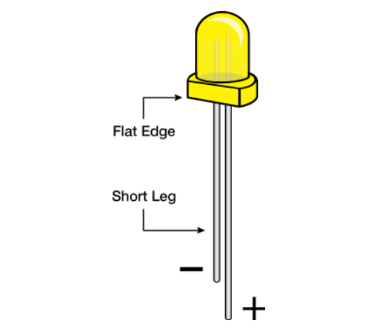
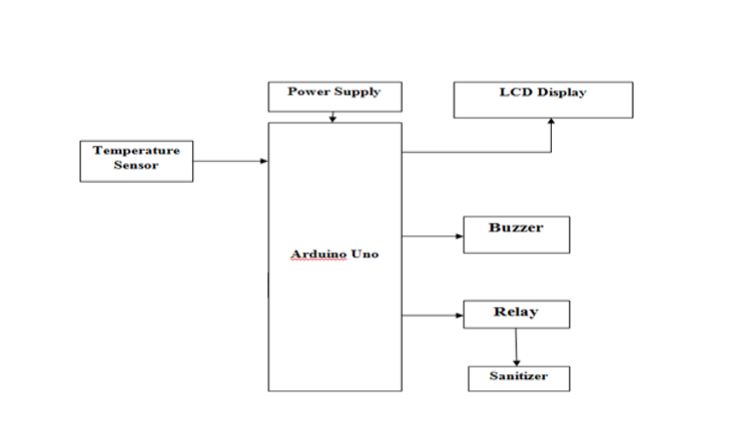
Model C
The main components of this project is the Arduino development board ,where all operation is being controlled.
1.An IC ML 35 is used as temperature sensor .It is intersected with the analog of AUB.
2.RTC ds 1307 for power supply

Slide 10
3.LCD Display :-if person have normal temp ,LCD display long edge (+) and if person have more then normal temp The shorter of the two legs, towards the flat edge of the bulb indicates the negative terminal(-).,Then Buzzers.

Slide 11
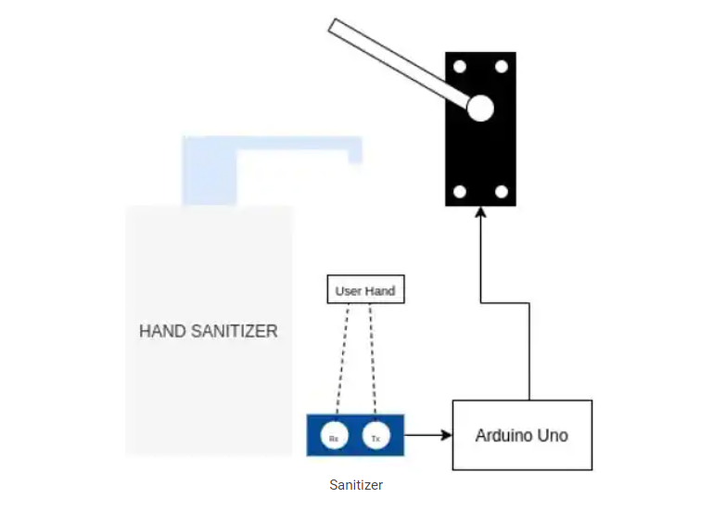
1. To actuate the servo to press the sanitizer tap whenever the sensor observes a low distance reading due to an obstruction in its line-of-sight. 2.When a person’s hand comes below the sanitizer obstructs the sensor line-of-sight, And the Arduino board receives a low distance reading and instructs the servo motor to actuate and dispense the sanitizer.
Model D

Slide 12
CONTRIBUTION TO THE SOCIETY
We are aiming to give proper accuracy in limited time so the chain reaction will be broken easily.
Healthy environment to the society is created.

Slide 13
Thank you

